Slide 1
MOLCAR WP1
SINTEF and WUT 2023 13th Visiting Warsaw
Notes:
Bildet illustrerer:
· bredden i SINTEFs ekspertise, fra havrom til verdensrom.
· hvilke områder og bransjer vi jobber innen for å realisere visjonen Teknologi for et bedre samfunn.
Bildestilen er basert på stikkordene fremtidsrettet, teknologi og norsk natur (naturressurser). SINTEFs visuelle univers er utviklet for SINTEF av Headspin Productions AS.

Slide 2
WP1
Task 1.1: Material screening of solid oxide ion conducting support materials.
Task 1.2: Novel oxides or carbonates can be dissolved into molten carbonates which can increases the oxide ion conductivity contributions.
Task 1.3: Manufacturing of composite membranes.
Task 1.4: Electrical and electrochemical characterization of new designed membranes.

Slide 3
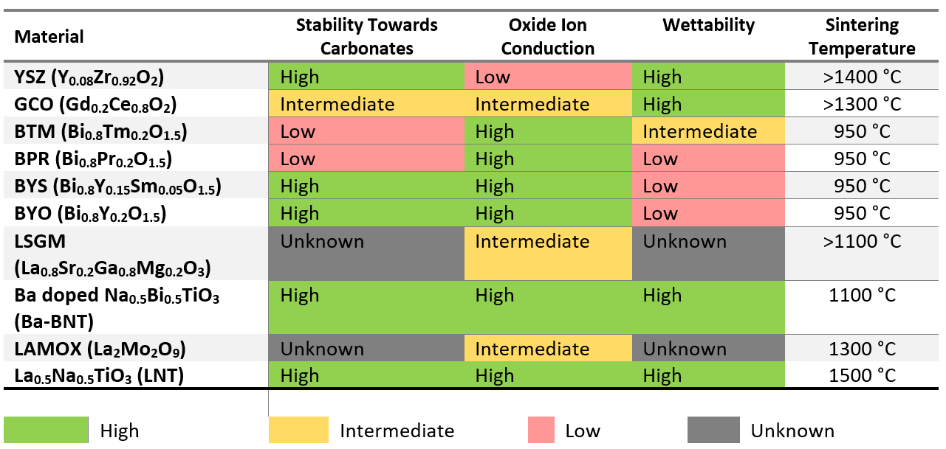
Material screening:

Slide 4
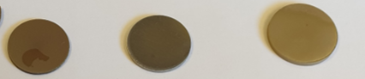
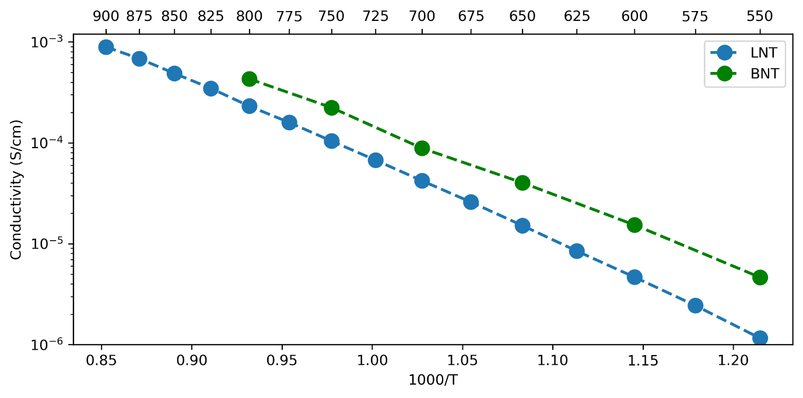
Ba-BNT and LNT
Solid state synthesis

Slide 5
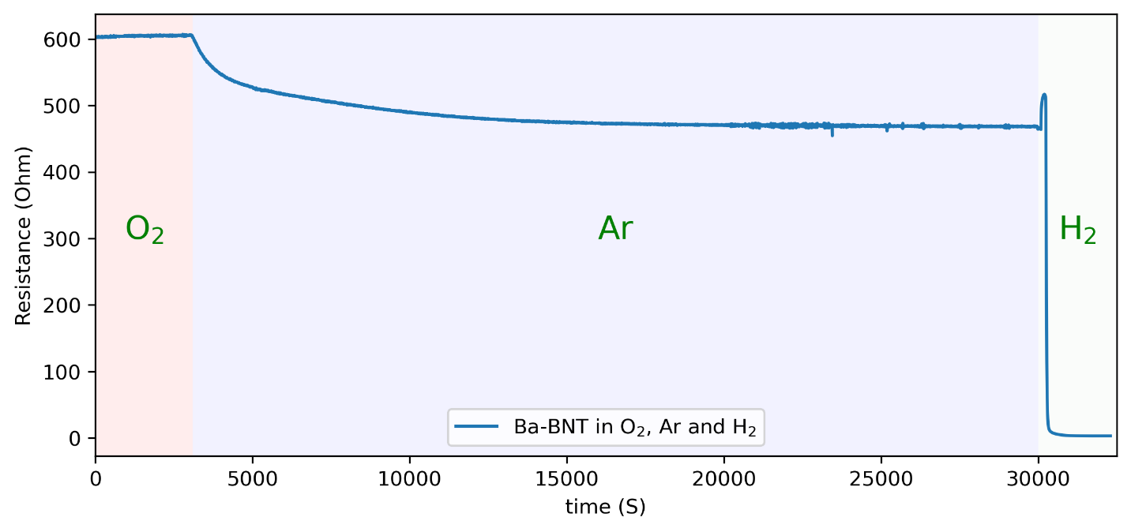
Ba-BNT

Slide 6
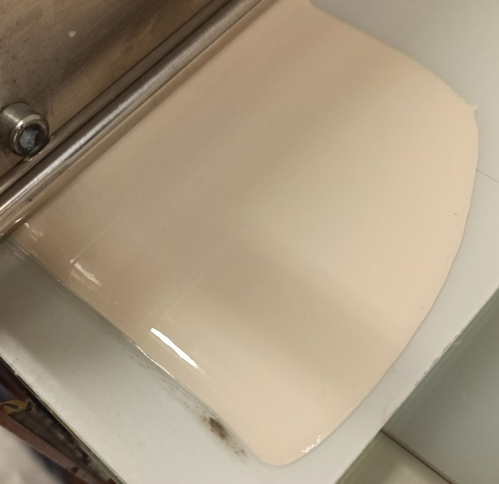
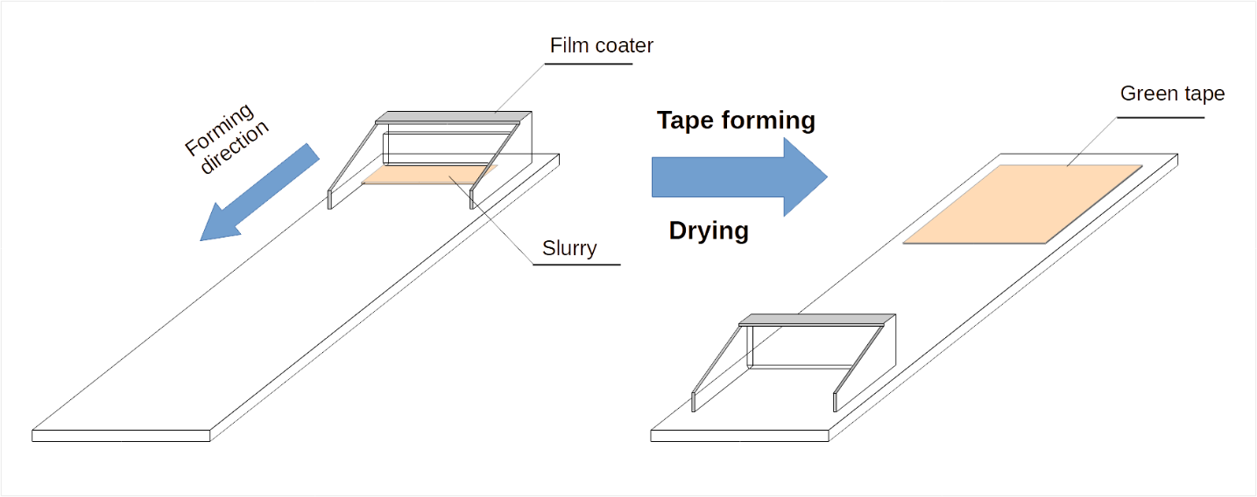
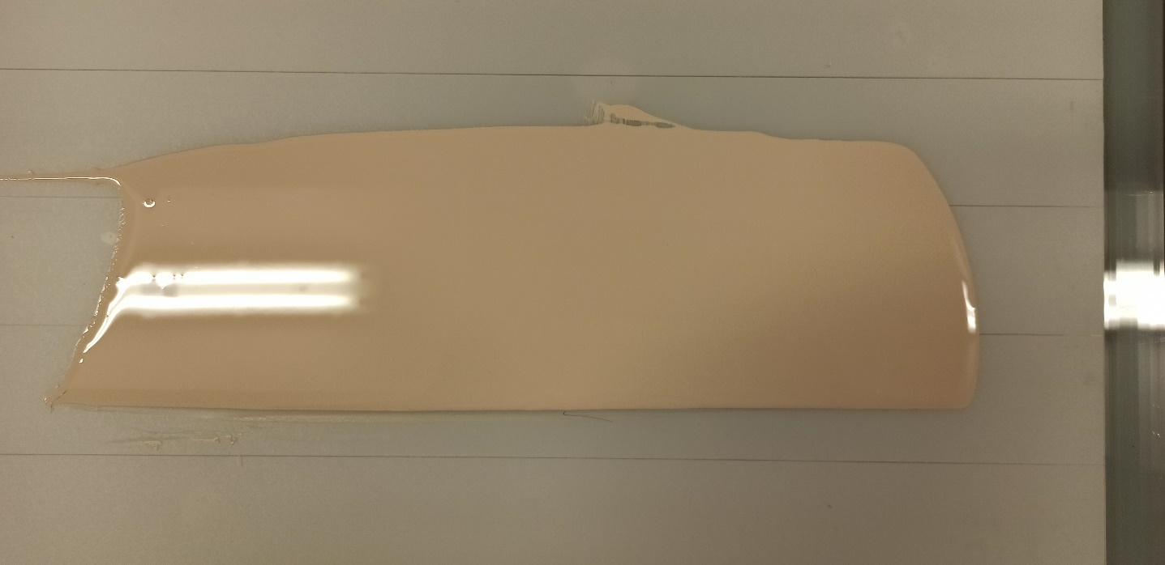
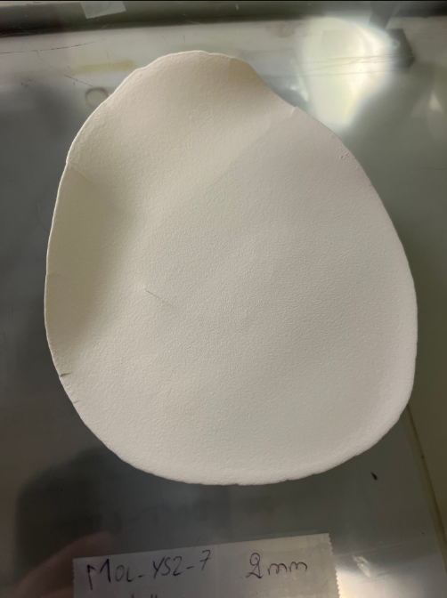
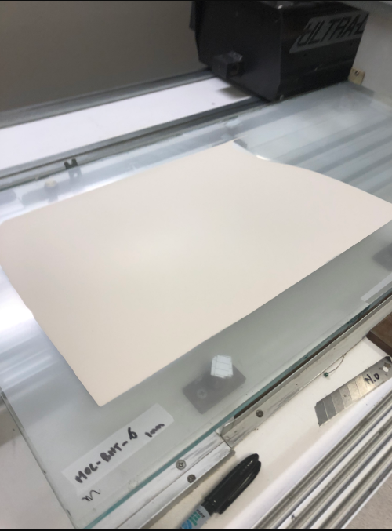
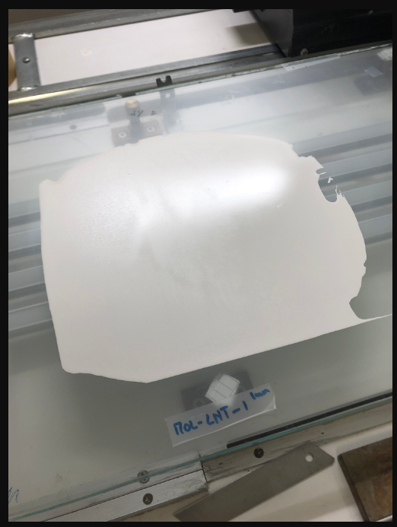
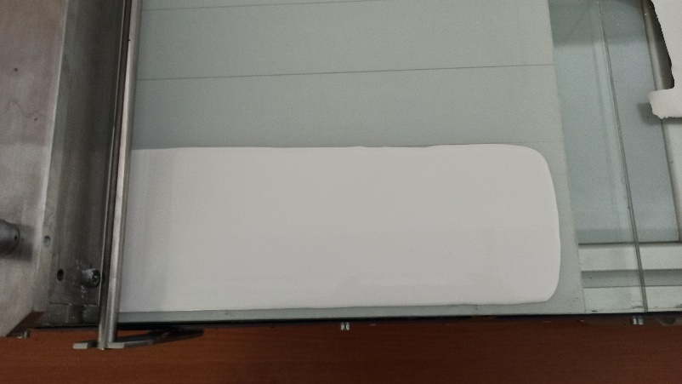
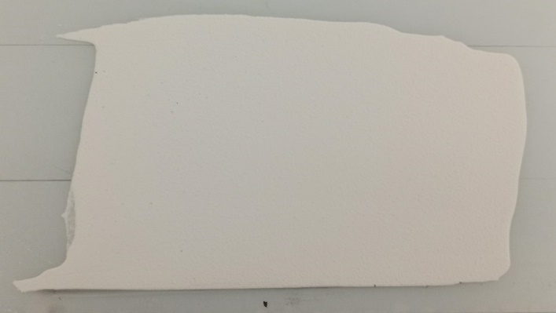
Sample fabrication

Slide 7
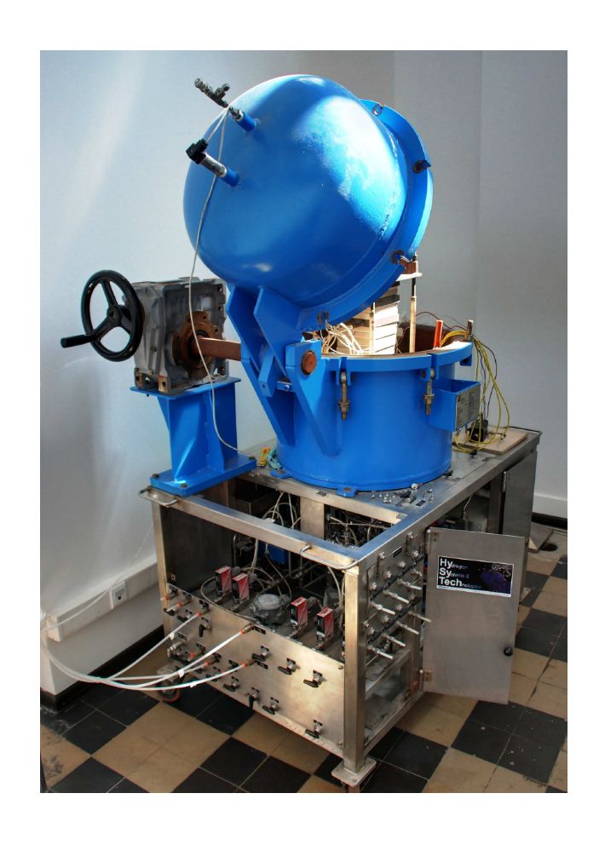
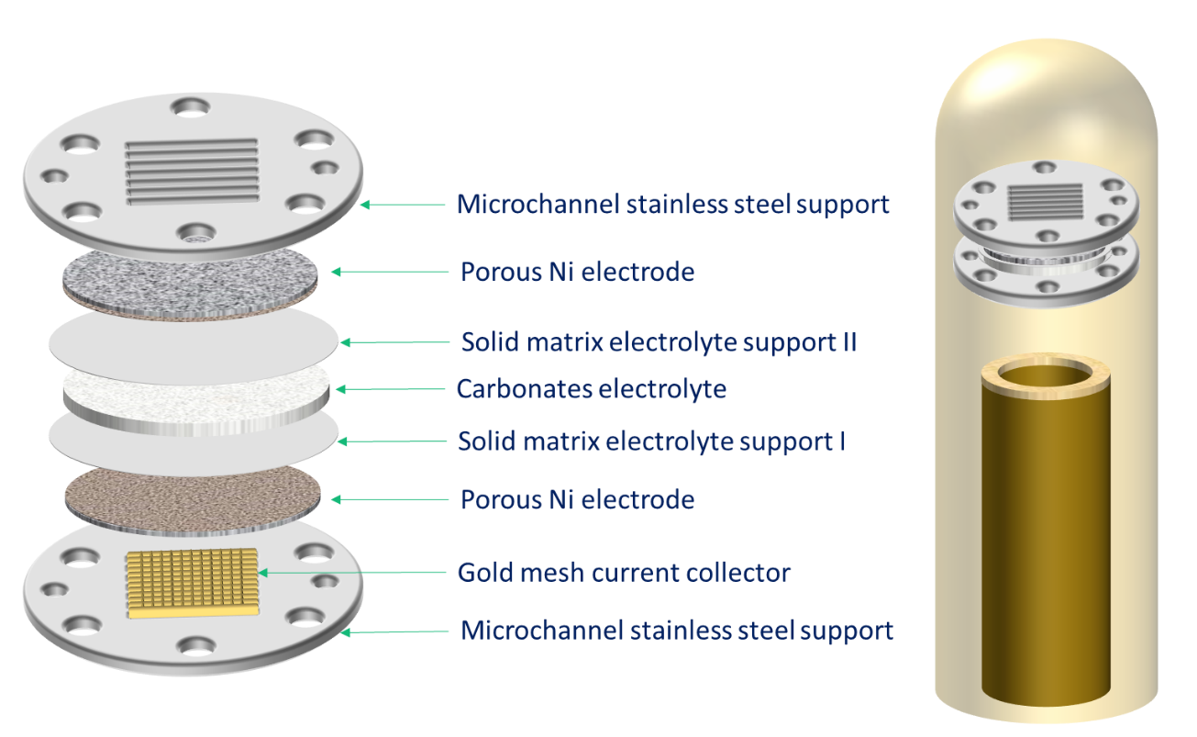
Testing cell setup

Slide 8
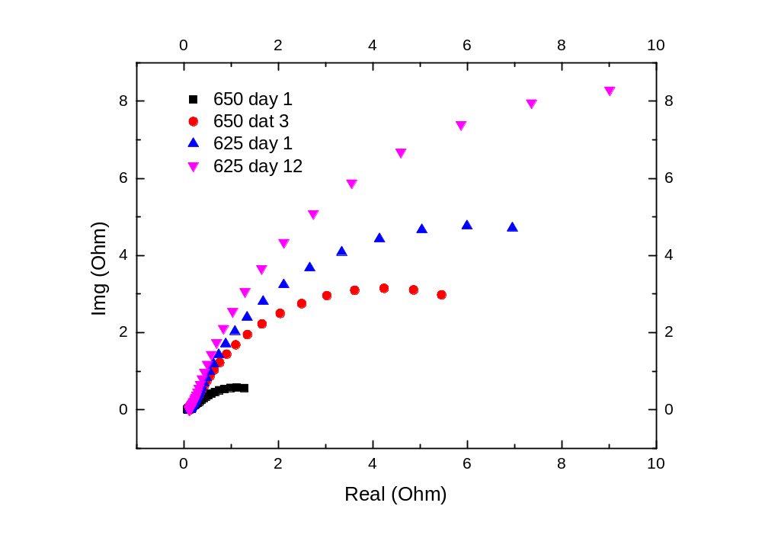
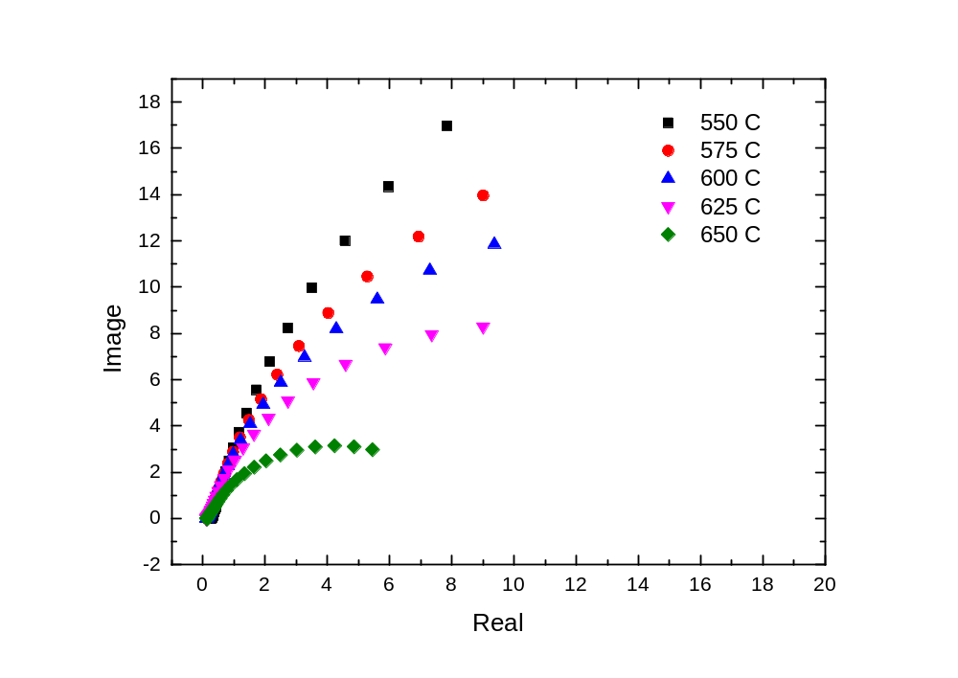
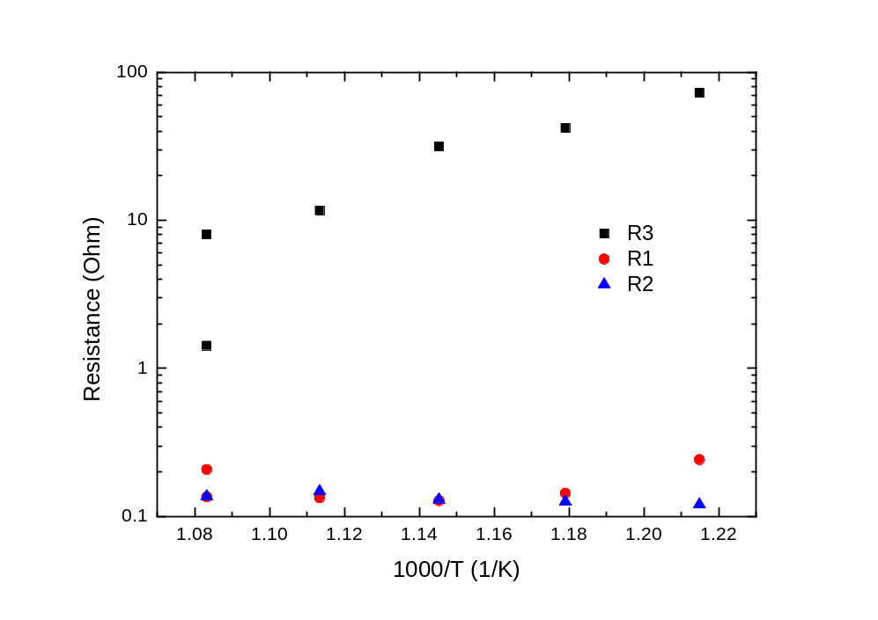
Impedance study – YSZ reference

Slide 9
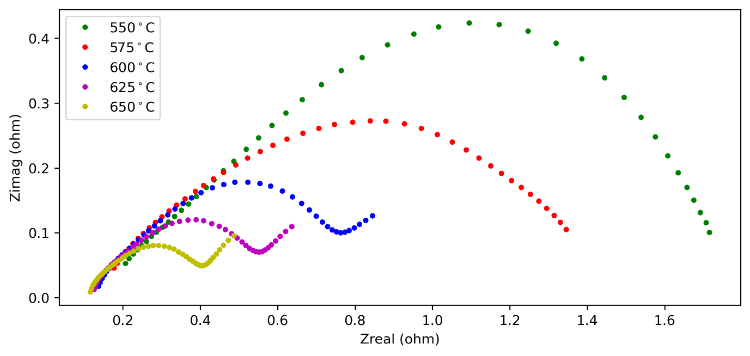
Impedance study – LNT-temperature

Slide 10
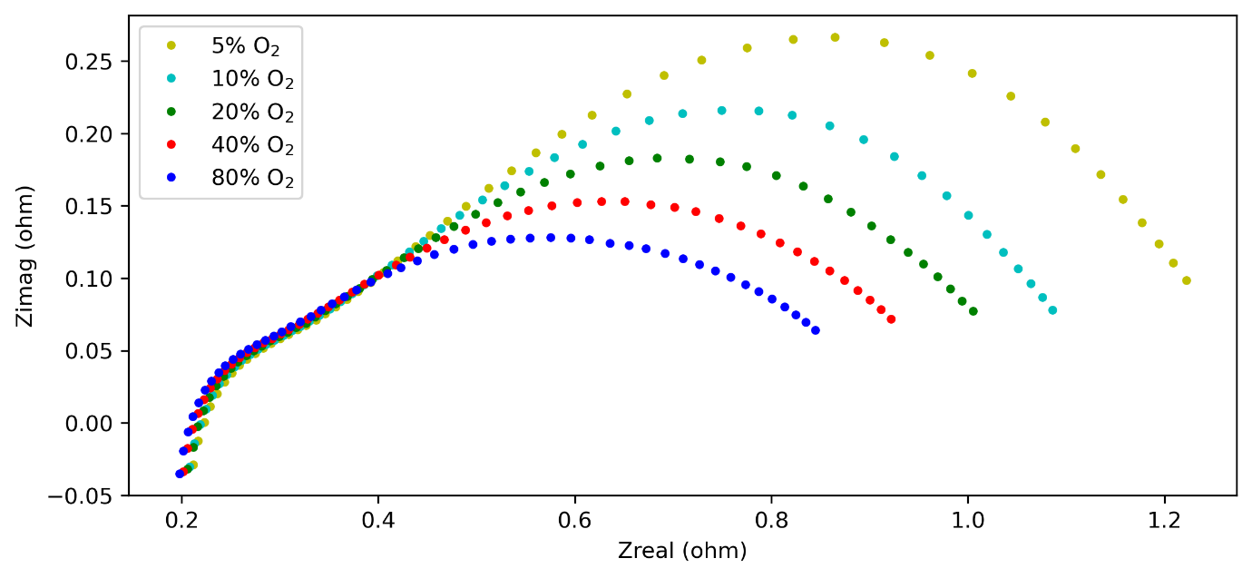
Impedance study – LNT-O₂%

Slide 11
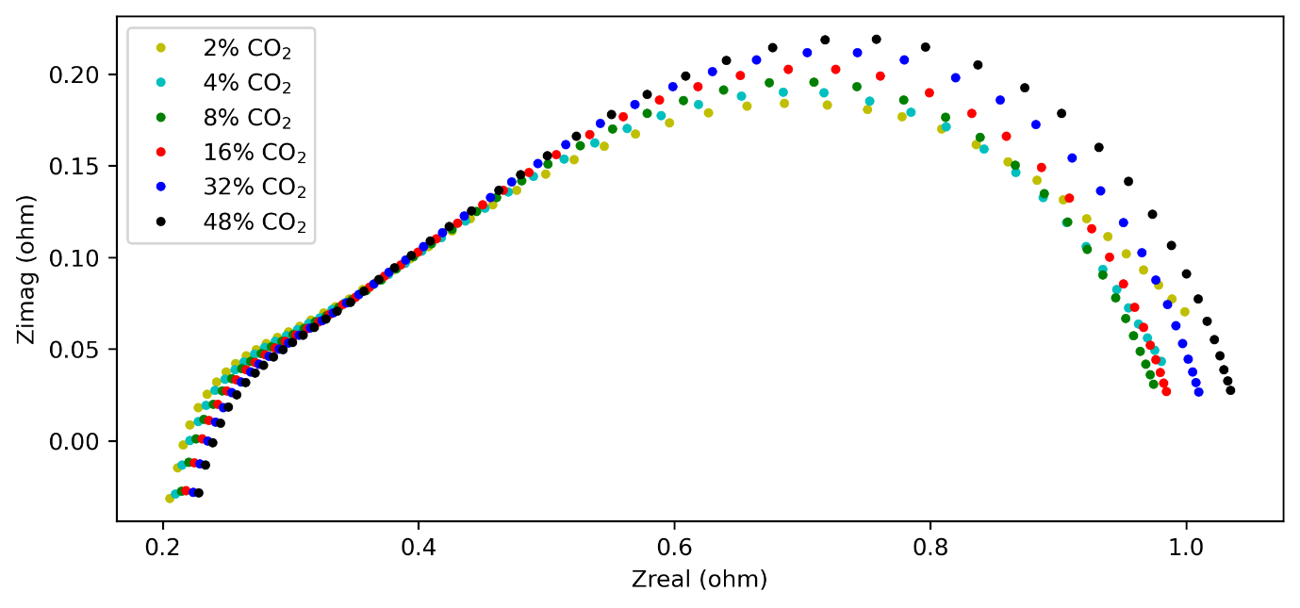
Impedance study – LNT-CO₂%

Slide 12
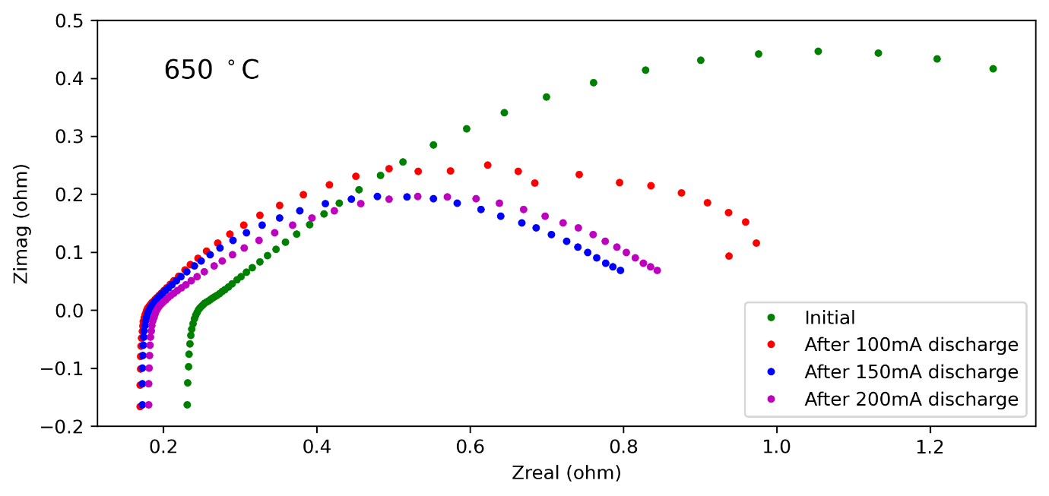
Impedance study – LNT-discharge

Slide 13
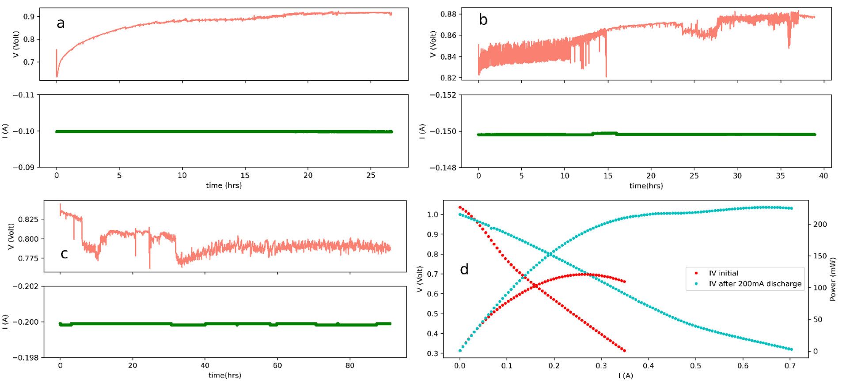
Power study – LNT-discharge

Slide 14
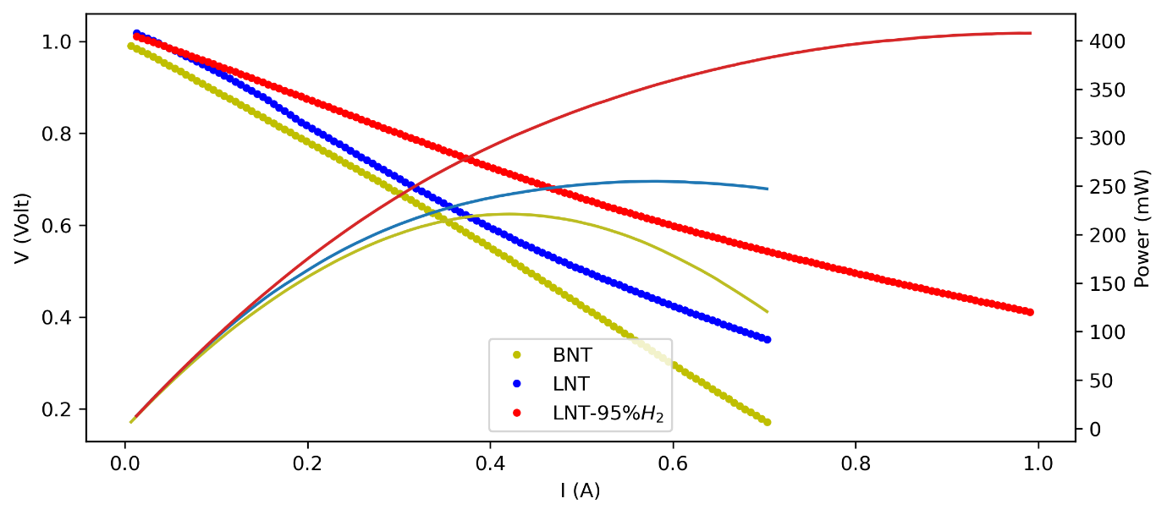
Power study – LNT,Ba-BNT comparison

Slide 15
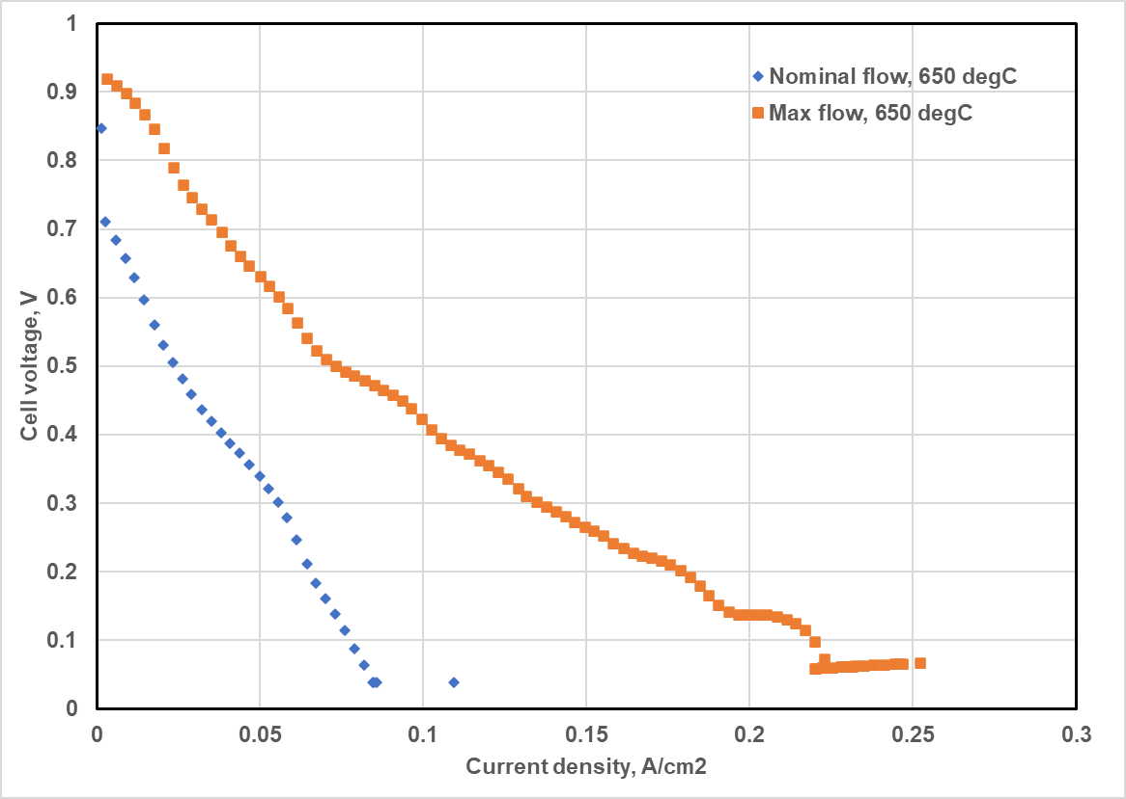
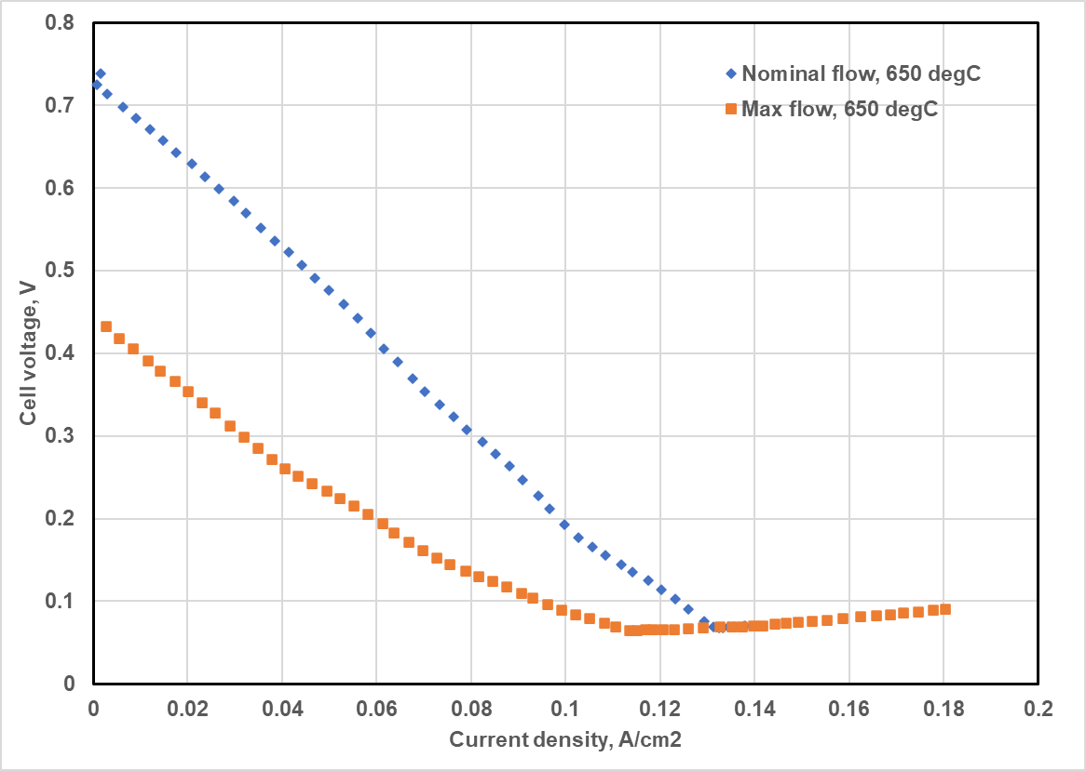
IV of BNT and LNT samples (larger cells)
BNT
LNT

Slide 16
Power out put for YSZ reference sample

Slide 17

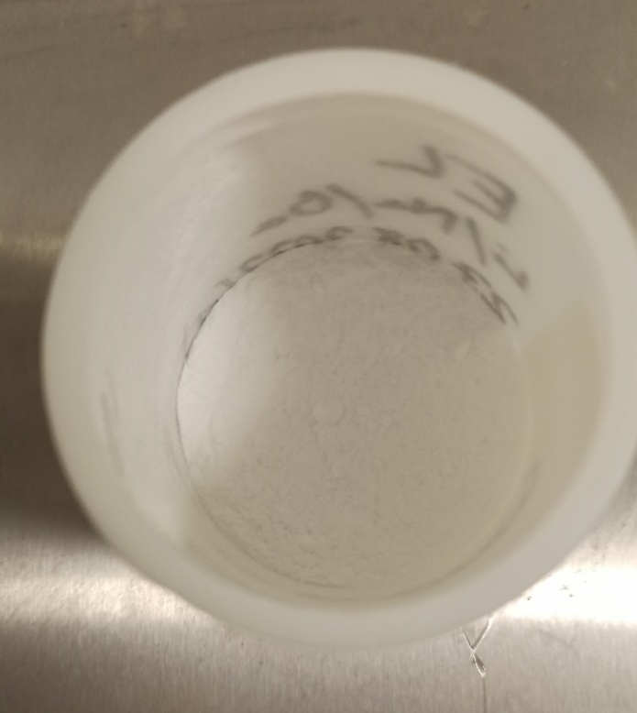
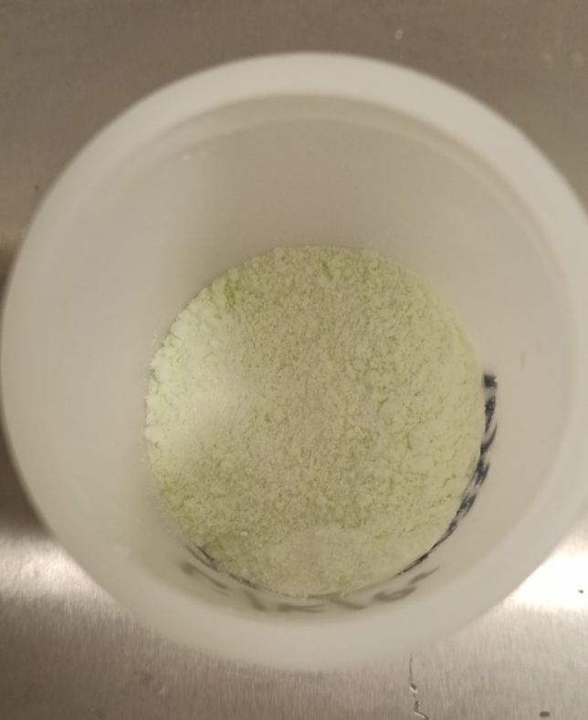
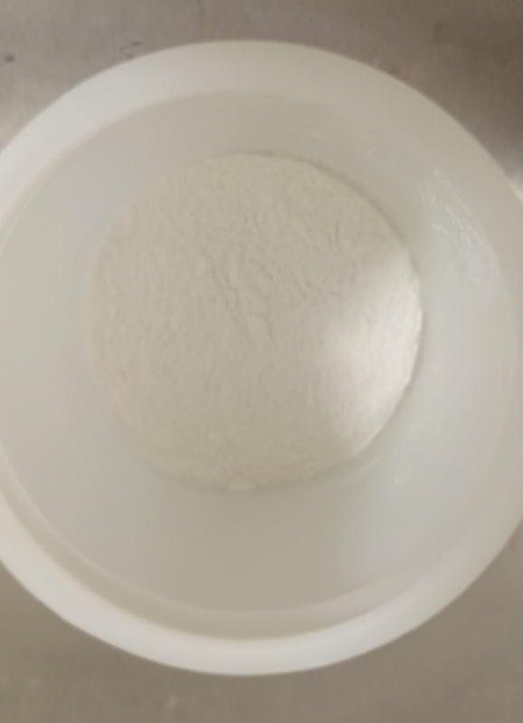
Oxides addition for electrolytes
Ba
Ca
Pr

Slide 18
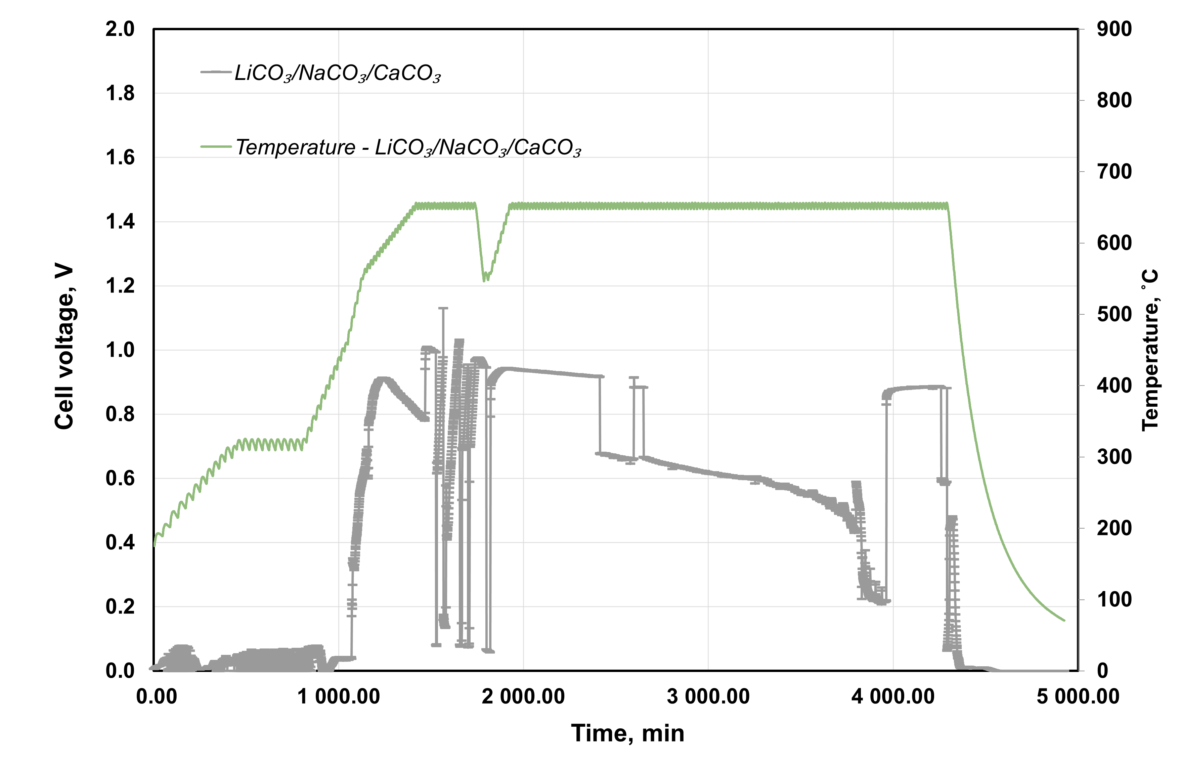
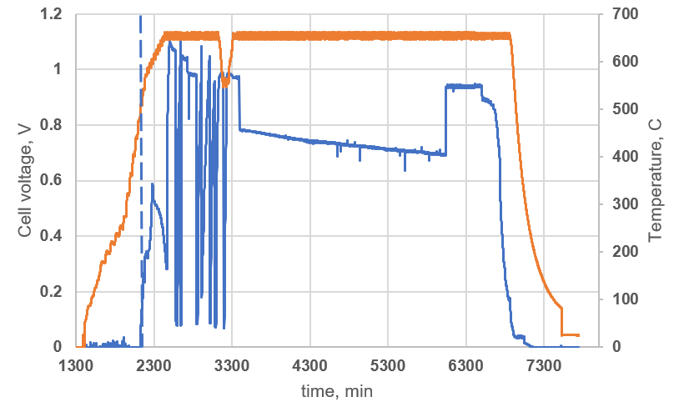
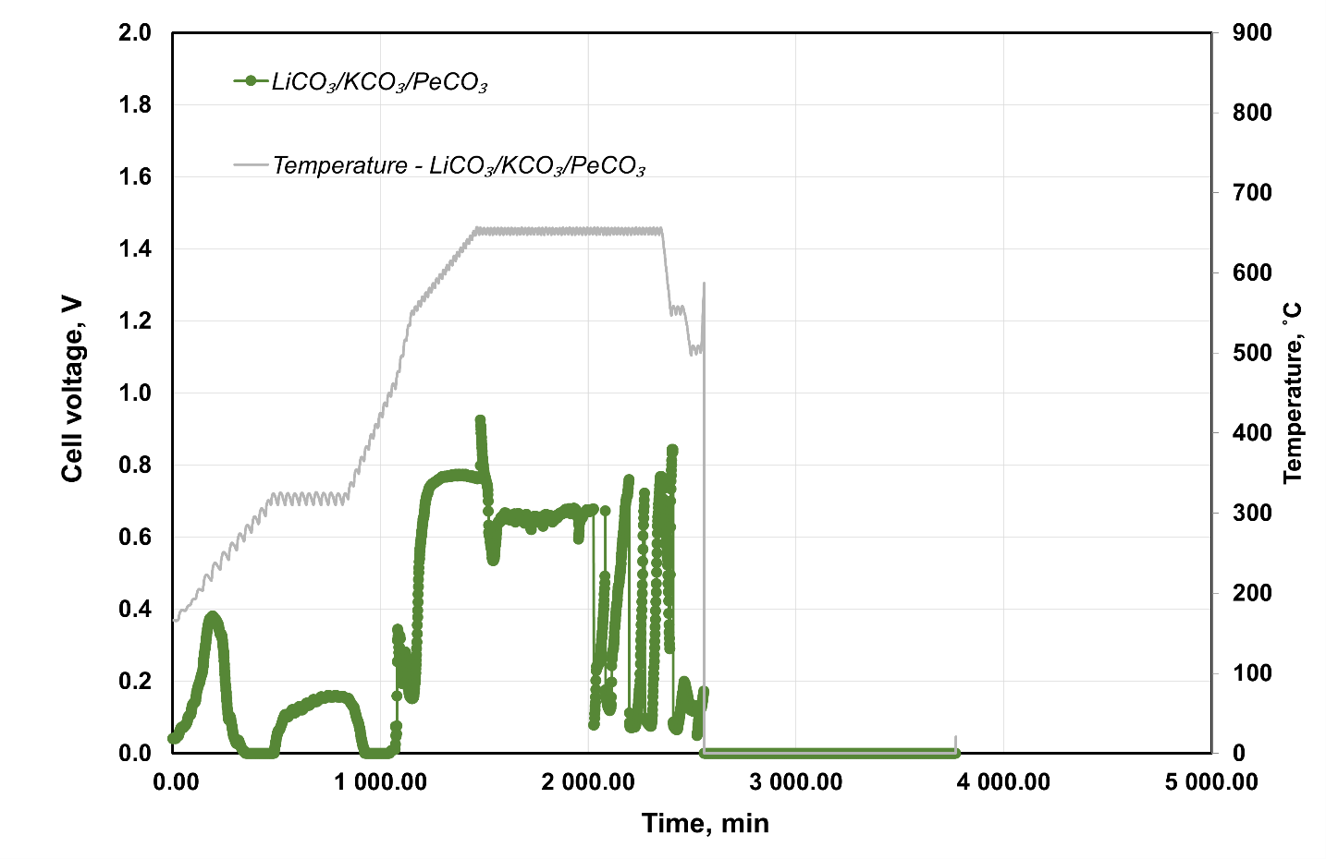
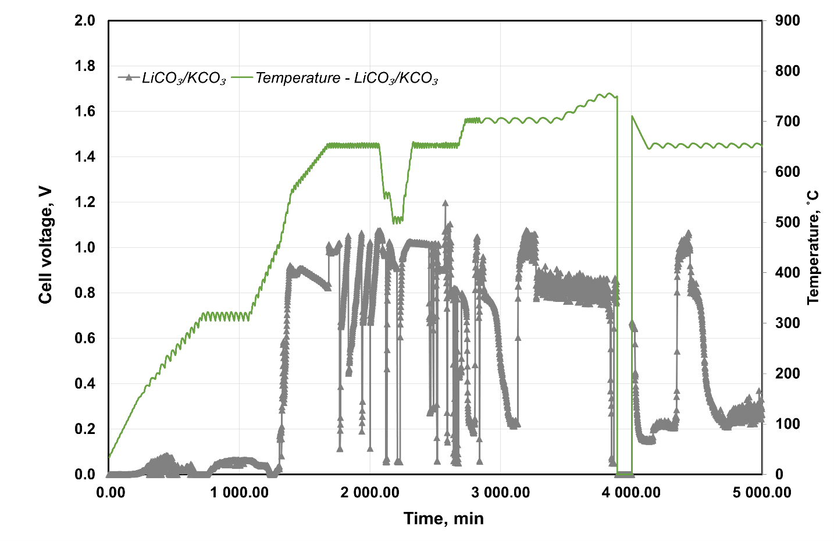
Measurement data of cell performance for different electrolytes

Slide 19
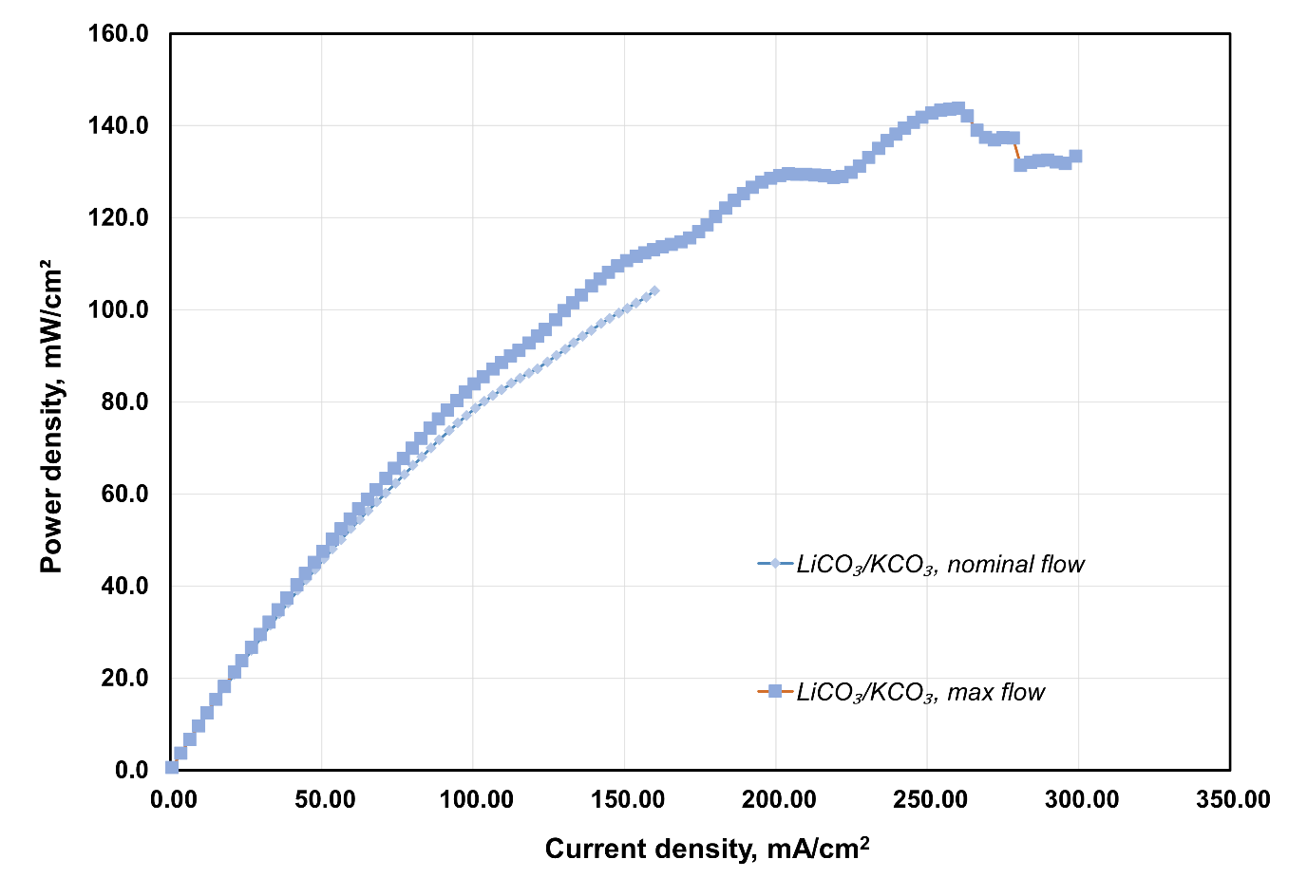
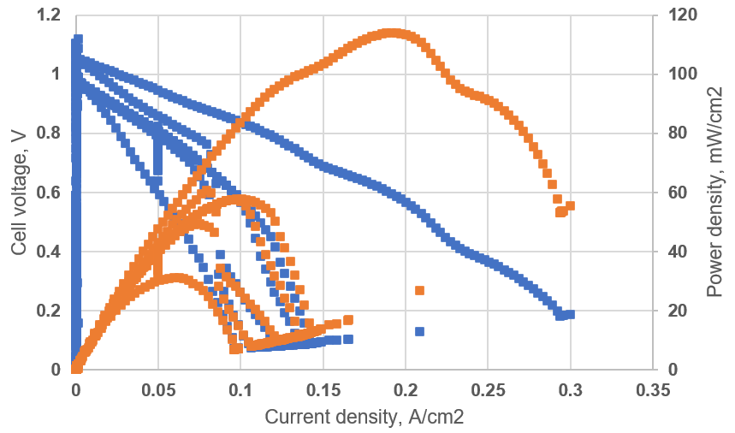
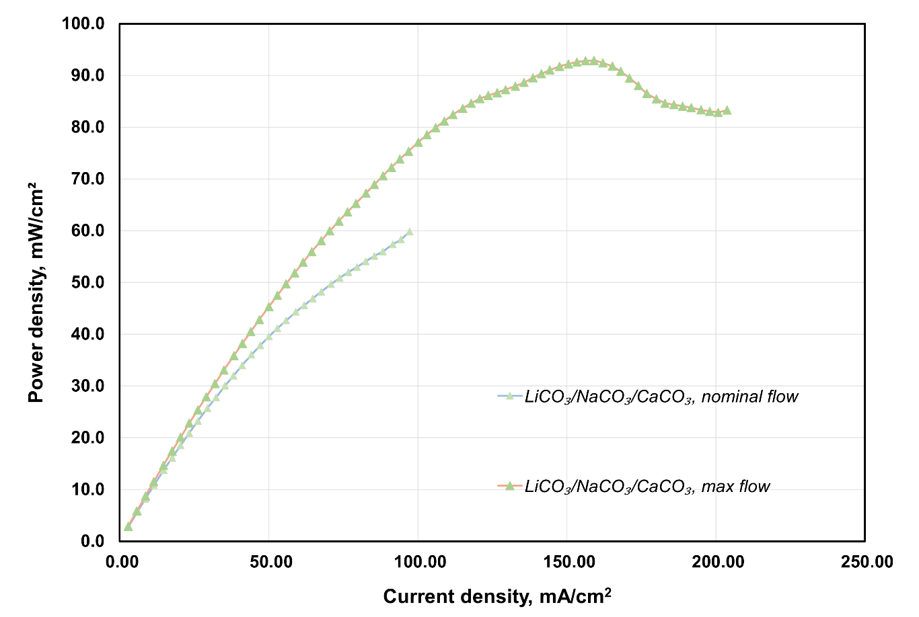
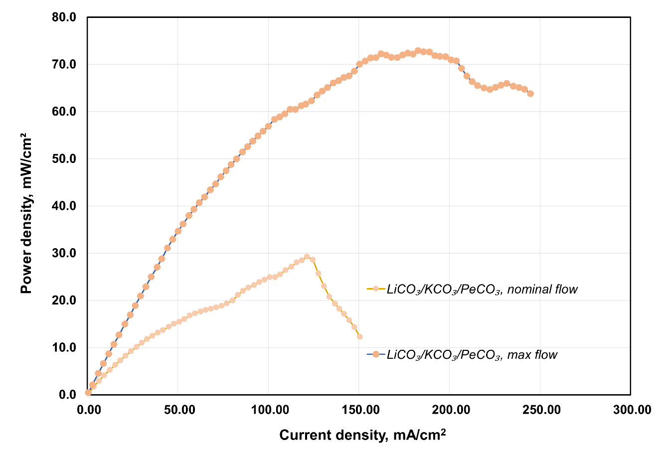
Ref.
Ba
Ca
Pr

Slide 20
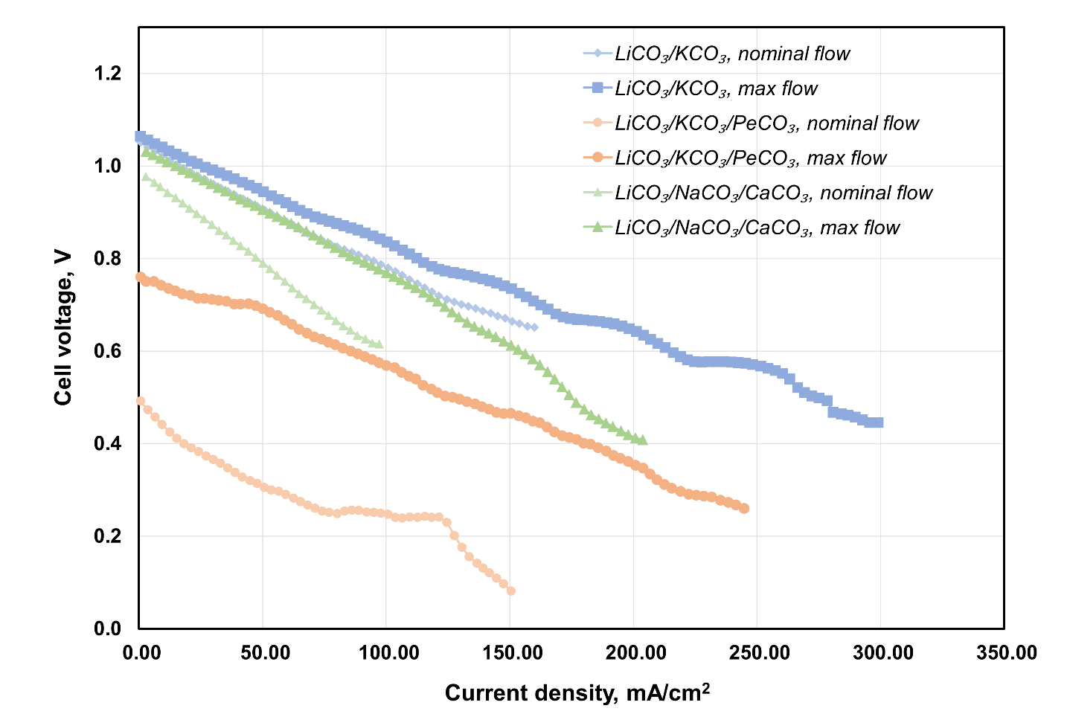
IV comparison

Slide 21
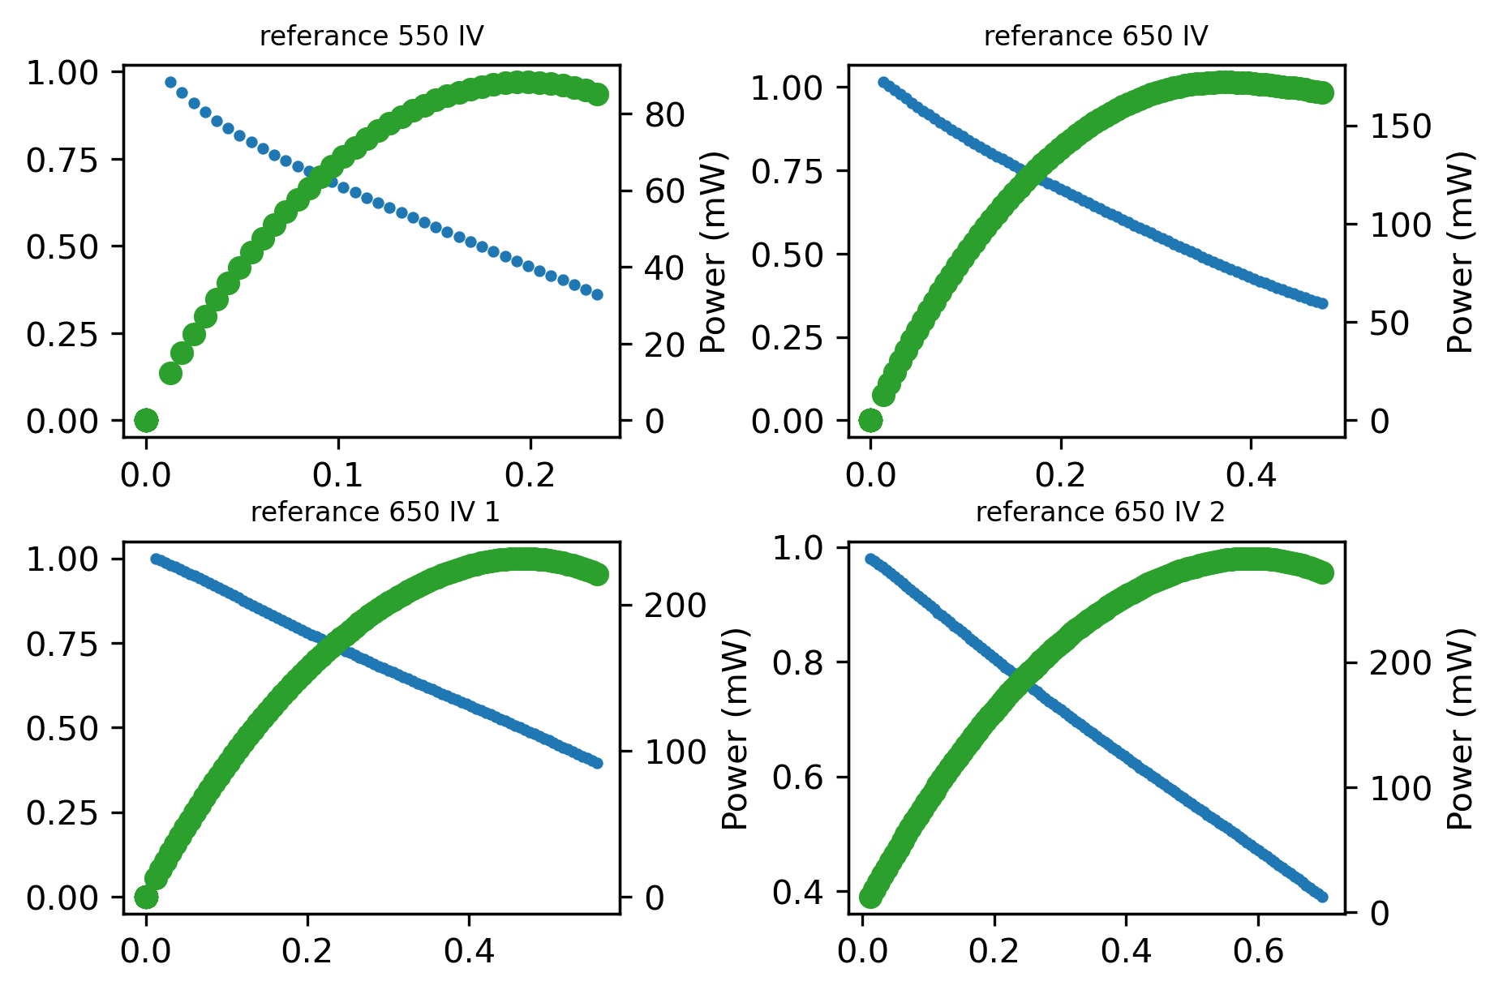
Cross-validation of YSZ supported sample

Slide 22
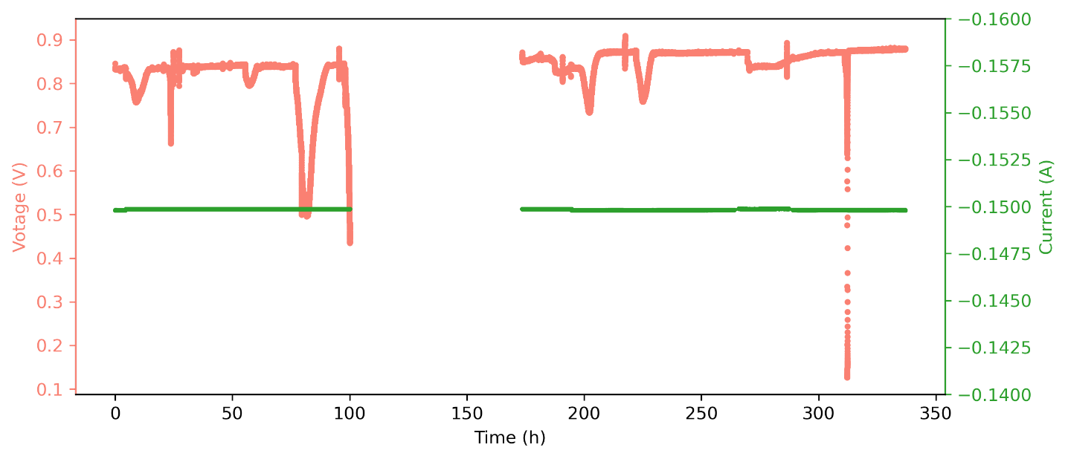
Cross-validation of YSZ supported sample

Slide 23
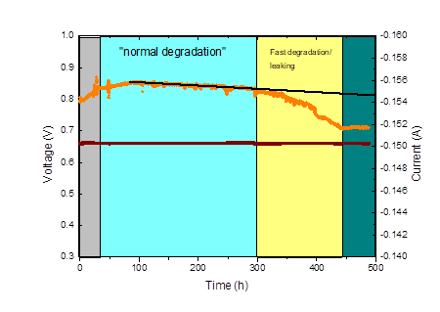
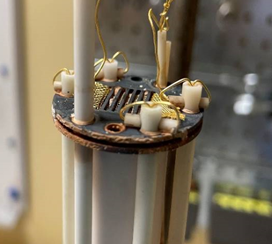
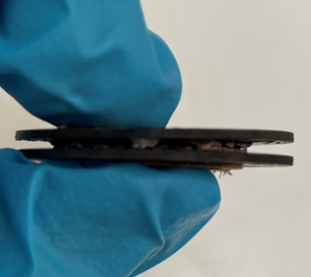
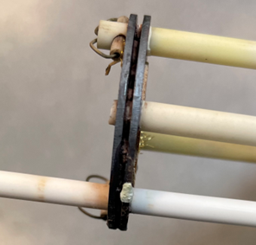
Durability studies - discharge

Slide 24
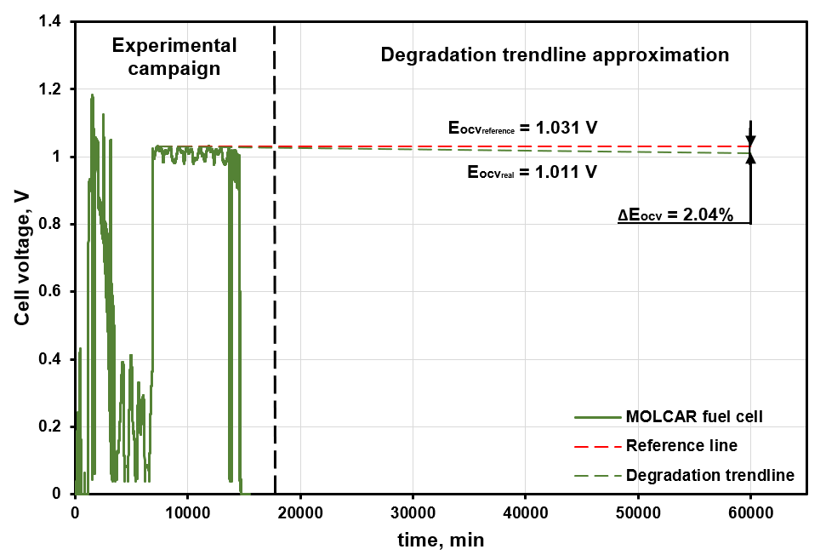
Durability studies -OCV

Slide 25
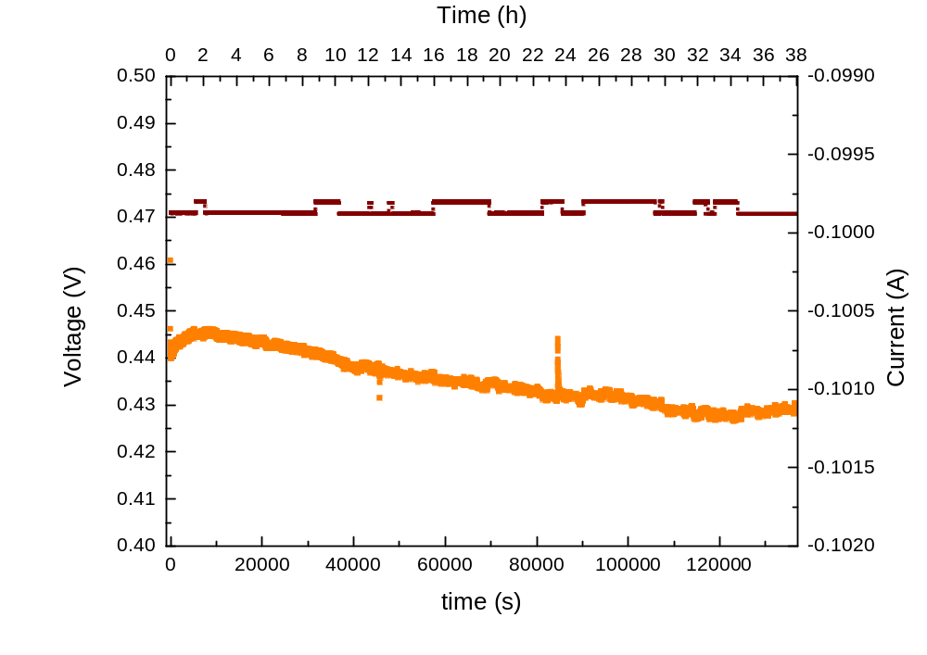
Stability of BNT cell

Slide 26
Summary
Experimental observation of high performance of new solid matrix materials of BNT and LNT can be concluded in a small test cell, but not in larger cell configurations due to potentially gas cross over
Oxides addition to the carbonates show lower performance of the cells but potentially extend the cell life time for reducing the electrode solubility
Tape casting method can effectively make cell components with different chemical compositions
Heavy corrosion of the stainless steel support plates were observed which prevent extended long term stability measurement of the cells and could be improved if better support materials were used

